Slide 1
Connect. Engage. Inspire.

Slide 2
Greater Oklahoma City Metro WAI Team
Women in Aviation International (WAI) is a nonprofit organization dedicated to the encouragement and advancement of women in all aviation and aerospace career fields and interests.
WAI began in 1990 with the goal to create a more inclusive workforce and sense of community for women who may not work with many other women in their daily lives.
Greater Oklahoma City Metro Chapter is a non-profit 501(c)(3) organization (EIN 88-44-13998) formed in early 2023 for women in the aviation industry who are passionate about inspiring the next generation to pursue STEM education including such areas as aviation, aircraft maintenance and manufacturing, as well as provide a forum to collaborate, network and develop as professionals.

Slide 3
WAI Mission Greater Oklahoma City Metro
Investing in our current and future workforce
Developing an inclusive and sustainable aviation and aerospace industry
Inspiring the pursuit of careers in aviation and aerospace
Foster aviation and aerospace education.
Creating and nurturing a network of aerospace professionals honoring the legacy of the Oklahoma aerospace industry and innovating for the future

Slide 4
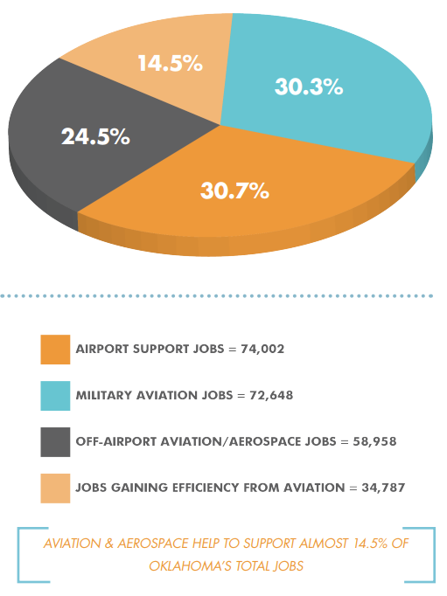
Oklahoma Aviation & Aerospace Workforce Economic Impacts
Aviation and Aerospace Economic Impacts Executive Summary

Slide 5
NATIONWIDE WOMEN IN AVIATION CAREERS:

Slide 6
THE FACTS, NATIONWIDE
STEM careers will earn 26% premium over non-STEM fields.
STEM jobs will increase by 13% in the next decade.
Women remain a minority of STEM workers in the United States. Women made up less than one-quarter (24%) of those employed in STEM occupations in 2015.
Women account for 5% of US airline pilots.
11% of graduates from a 4-year aviation collegiate program are women.
Women in STEM fields earn 33% more on average over other fields.

Slide 7
Current Workforce Women in the Aerospace Industry - Oklahoma
Job Description | Total Jobs | Females | % of Occupation | Average Annual Earnings
Software Developers | 3,430 | 739 | 22% | $103,369
Aircraft Mechanics & Service Technicians | 2,730 | 193 | 7% | $57,776
Electronics Engineers, Except Computer | 1,231 | 129 | 11% | $95,228
Engineers, All Other | 1,149 | 164 | 14% | $104,322
Mechanical Engineers | 963 | 82 | 9% | $89,270
Architectural and Engineering Managers | 957 | 109 | 11% | $148,870
Electrical Engineers | 816 | 80 | 10% | $100,066
Industrial Engineers | 771 | 161 | 21% | $98,867
Aerospace Engineers | 528 | 74 | 14% | $110,655
Airline Pilots, Copilots & Flight Engineers | 414 | 33 | 8% | $123,584
Commercial Pilots | 319 | 24 | 8% | $105,774
Air Traffic Controllers | 197 | 38 | 19% | $128,000
Source: EMSI occupation employment data are based on final EMSI industry data and final EMSI staffing patterns. Wage estimates are based on Occupational Employment Statistics (QCEW and Non-QCEW Employees classes of worker) and the American Community Survey (Self-Employed and Extended Proprietors). Occupational wage estimates are also affected by county-level EMSI earnings by industry

Slide 8
WAI Scholarships Change Lives: STEM Workforce as a Contributor to Economic Vitality

Slide 9
WAI Scholarships A Success Story
Cumulative Value of Scholarships Awarded
Annual Value of Scholarships Awarded
$880K+ in 2022
Over $15.4M Cumulative
US Dollars

Slide 10
Scholarships Post-Secondary Education
Fundraising event to raise money to fuel WAI missions
First Annual Girls in Aviation Day, September 23, 2023 located AAR Corp, located at Will Rogers World Airport
Girls, ages 8-18, were introduced to the career and lifestyle possibilities in aviation and aerospace through meeting role models, career panels, exploring airplanes/ helicopter a hands-on approach to pique interest in the STEM fields of science, engineering, technology and math
Looking to connect with community members and corporate sponsors who wish to support our mission and the Girls in Aviation Day event

Slide 11
Up Coming Event Greater Oklahoma City Metro 1st Annual Girls in Aviation Day
American Airlines and OSU-Tulsa host Girls in Aviation Day 2022
More than 100 young women attended the Girls in Aviation Day event to learn about the exciting field of aviation.

Slide 12
Annual Conference By the Numbers

Slide 13
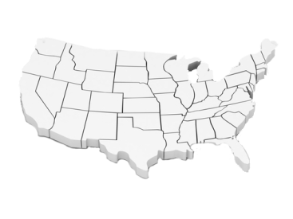
Host the WAI Annual conference Oklahoma City
Regional Conference
Seattle, WA
Minneapolis, MN
Reno, NV
Denver, CO
St.Louis, MO
Las Vegas, NV
Cincinnati, OH
Nashville, TN
Long Beach, CA
Memphis, TN
Atlanta, GA
Prescott, AZ
Dallas, TX
Orlando, FL 2024
OKC OK 2028
Oklahoma City, OK 2028 or 2029

Slide 14
Conference Registration History
Conference Registration

Slide 15
Orlando, FL: March 21-23, 2024

Slide 16
Growing Membership Ranks

Slide 17
Membership Ranks Continue to Grow
Over 90% growth since 2009
Active Membership

Slide 18
Membership Today
More than 18,000+ Active Members
12,000+ Individual Members & Family
~4,300+ Student Members
~2600 Junior (18 and Under) Members
400+ Corporate Members
1000+ International Members Representing 90 countries

Slide 19
International Membership 1000+ Members from 90 Countries (Outside the U.S.A.)

Slide 20
Worldwide WAI Chapters

Slide 21
31 International Chapters – 22 Countries Year-Round Networking & Local Outreach
42% of WAI Members are Chapter Members
118 in US

Slide 22
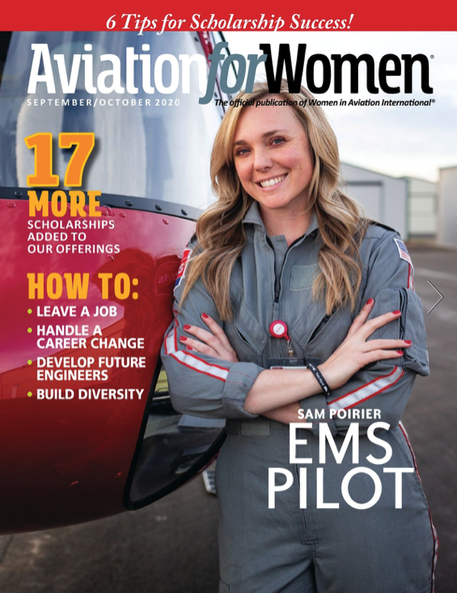
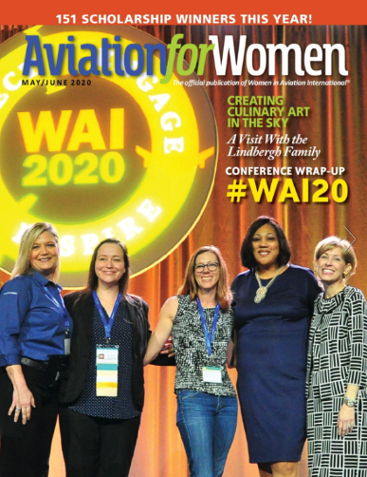
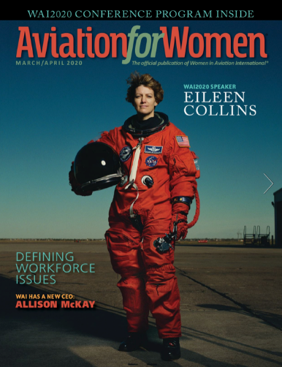
Aviation for Women Magazine
Began in 1998
Articles focus on current women throughout the aviation industry
Job, Mentorship, and scholarship information provided

Slide 23
WAI WELCOMES NEW JUNIOR MEMBERS!
Are you 18 years old or younger?
Do you love aviation and STEM?
Do you want to learn more about living your aviation passion?
Are you interested in finding out more about scholarships in aviation?
We have a free WAI membership for you!
Join for free here and learn about all the resources and benefits at
WAI.org/membership-information

Slide 24
Mentorship Program
One of our most important Member Benefits
Be a Mentor
Find a Mentor
www.wai.org –Member Benefits

Slide 25
Jobs Connect
Spring 2019

Slide 26
WAI – a Very Unique and Inclusive Group

Slide 27
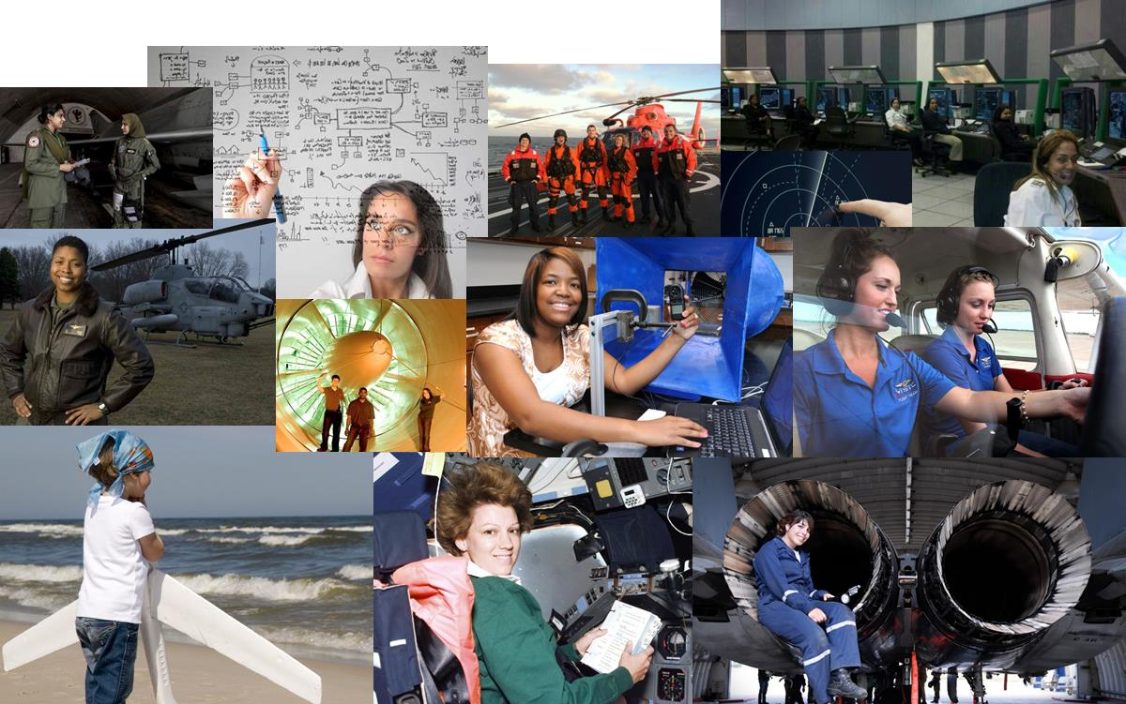
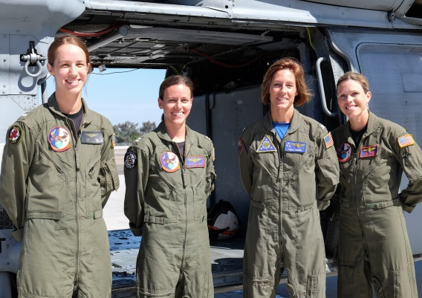
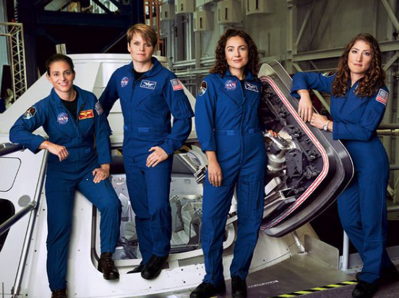
What makes WAI unique? Not just for pilots…WAI members do it all!

Slide 28
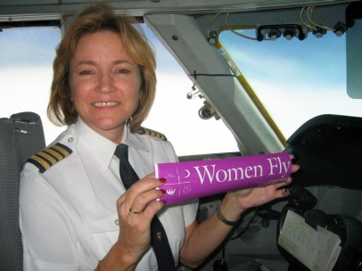
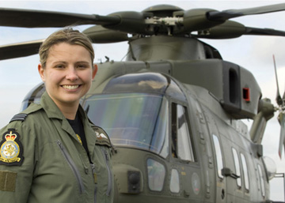
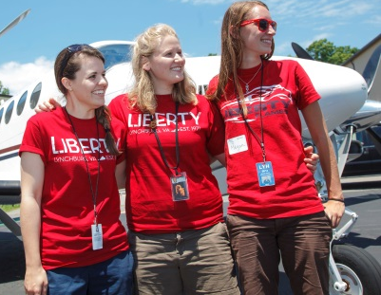
What makes WAI unique?
Members represent all segments of the industry:
Commercial
Corporate
General
Military
Women and Men
(Approximately 22% of members are men)

Slide 29
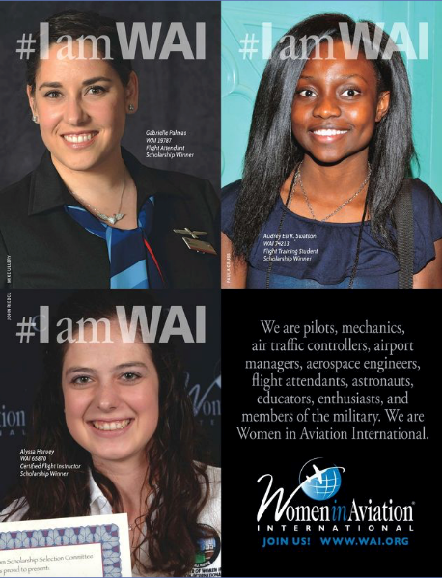
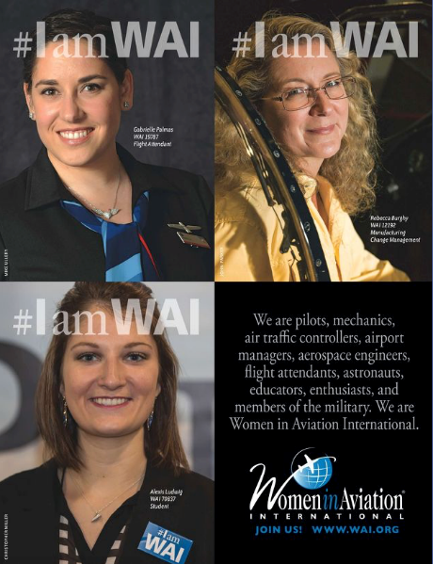
What makes WAI unique?
Members from all experience levels & age groups!
students
20’s
30’s
40’s
50’s
60’s
70’s & beyond

Slide 30
WAI Outreach

Slide 31
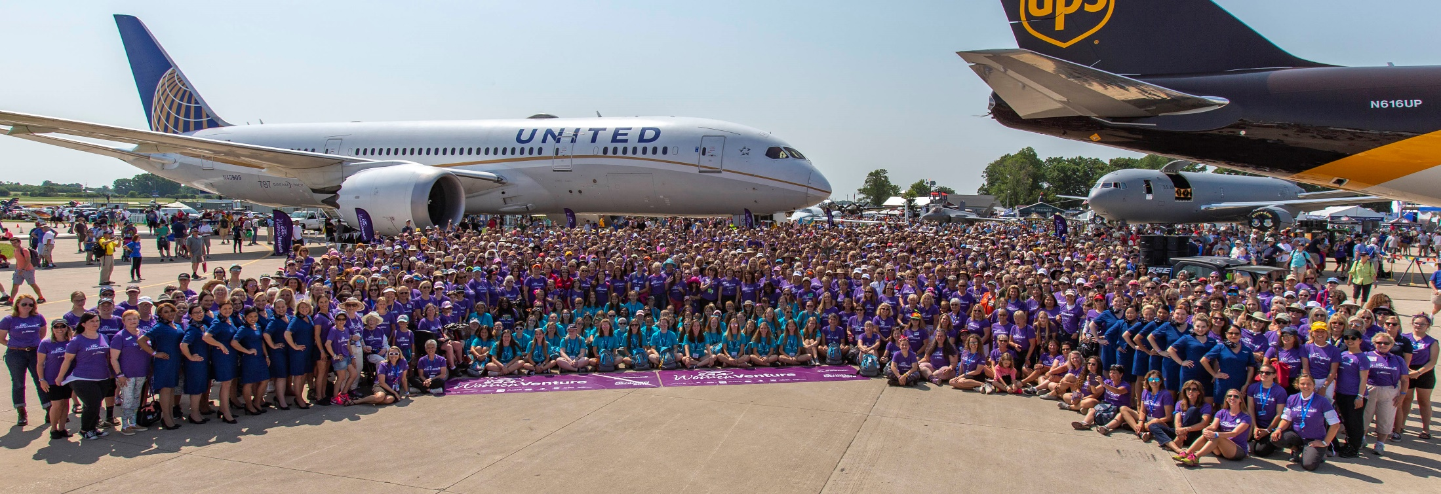
Media Outreach, Tradeshow Presence & Events, Group Engagement

Slide 32
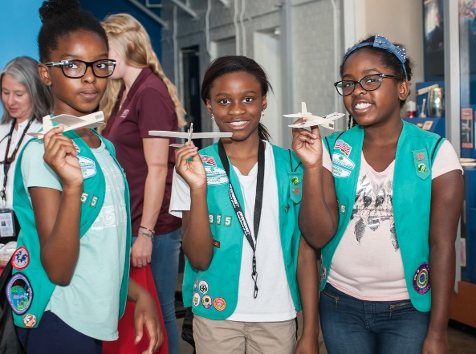
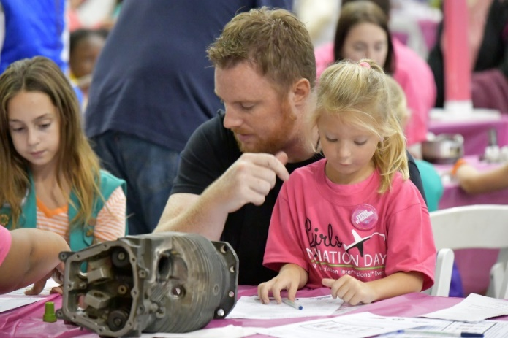
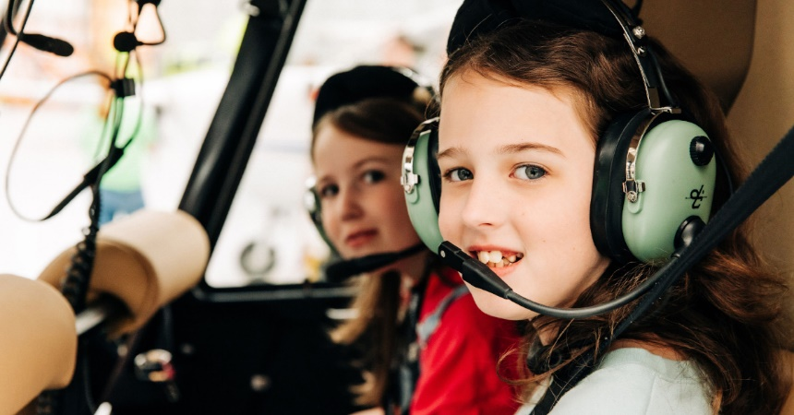
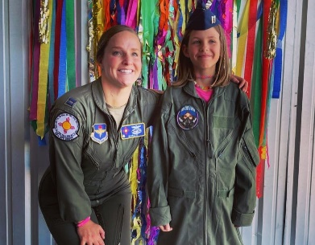
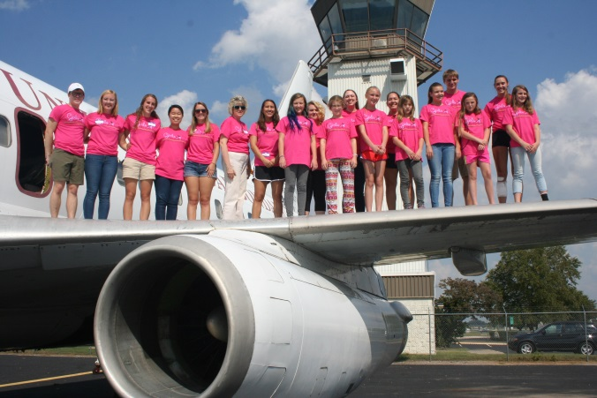
September 23, 2023

Slide 33
Year | # of Events | # of Attendees
2015 | 39 | 3,850
2016 | 67 | 4,900
2017 | 77 | 9,700
2018 | 101 | 15,200
2019 | 103 | 20,000
2020 | VIRTUAL ONLY – Over 55 Countries Reached with App
2021 | 85 | 10,000
2022 | 124 | 16,000

Slide 34
Women in Aviation… …Tomorrow

Slide 35
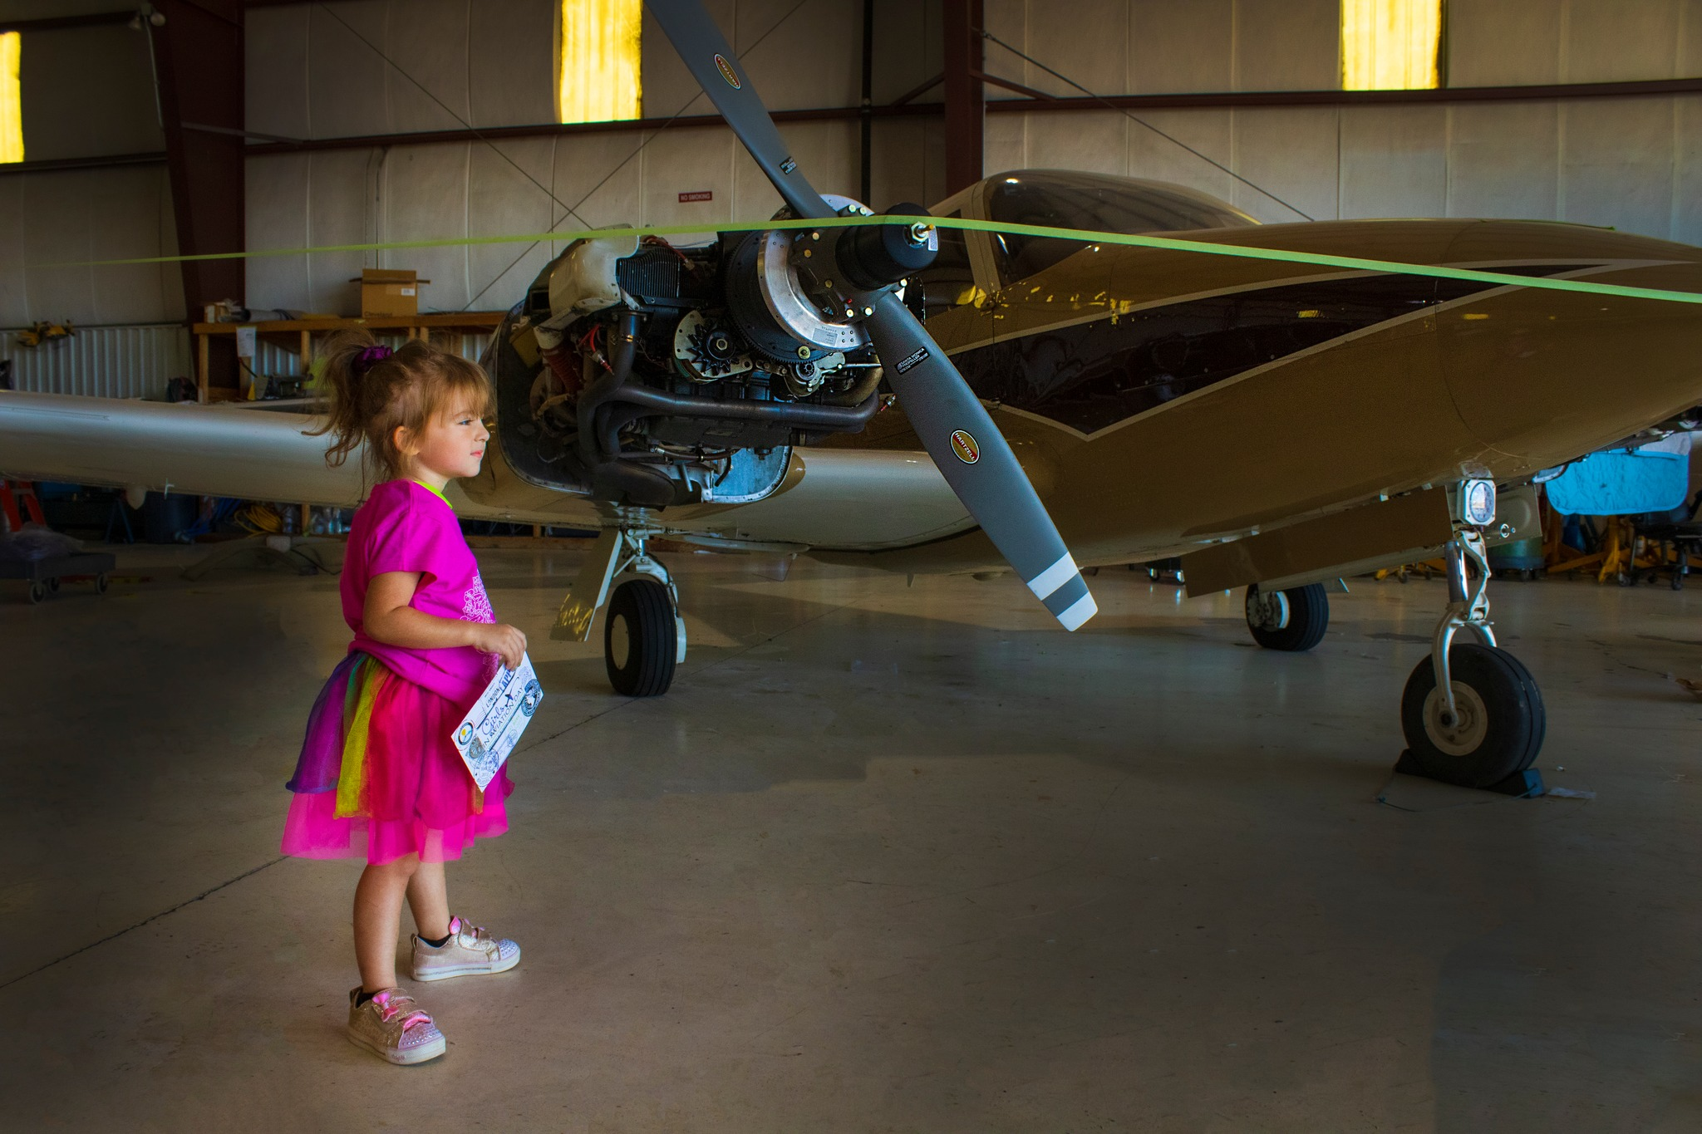
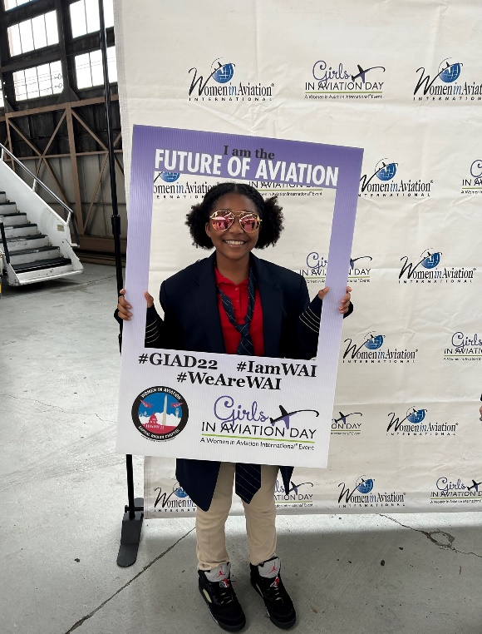
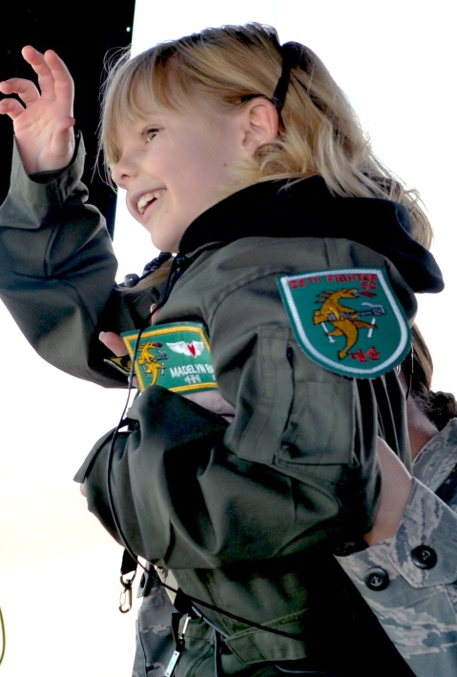
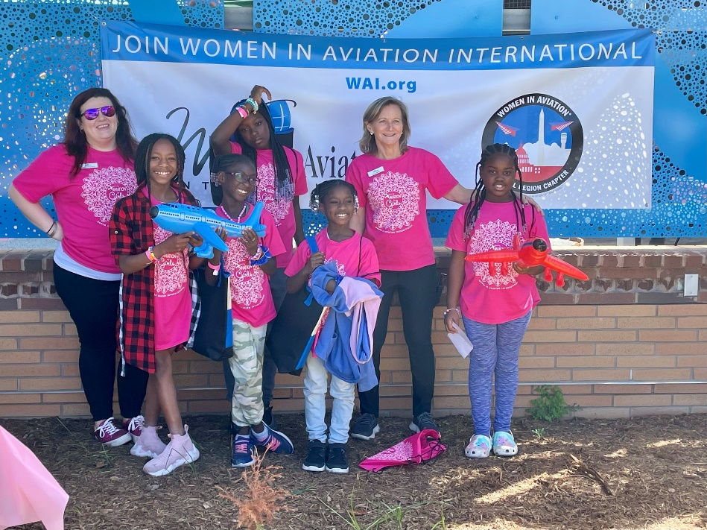
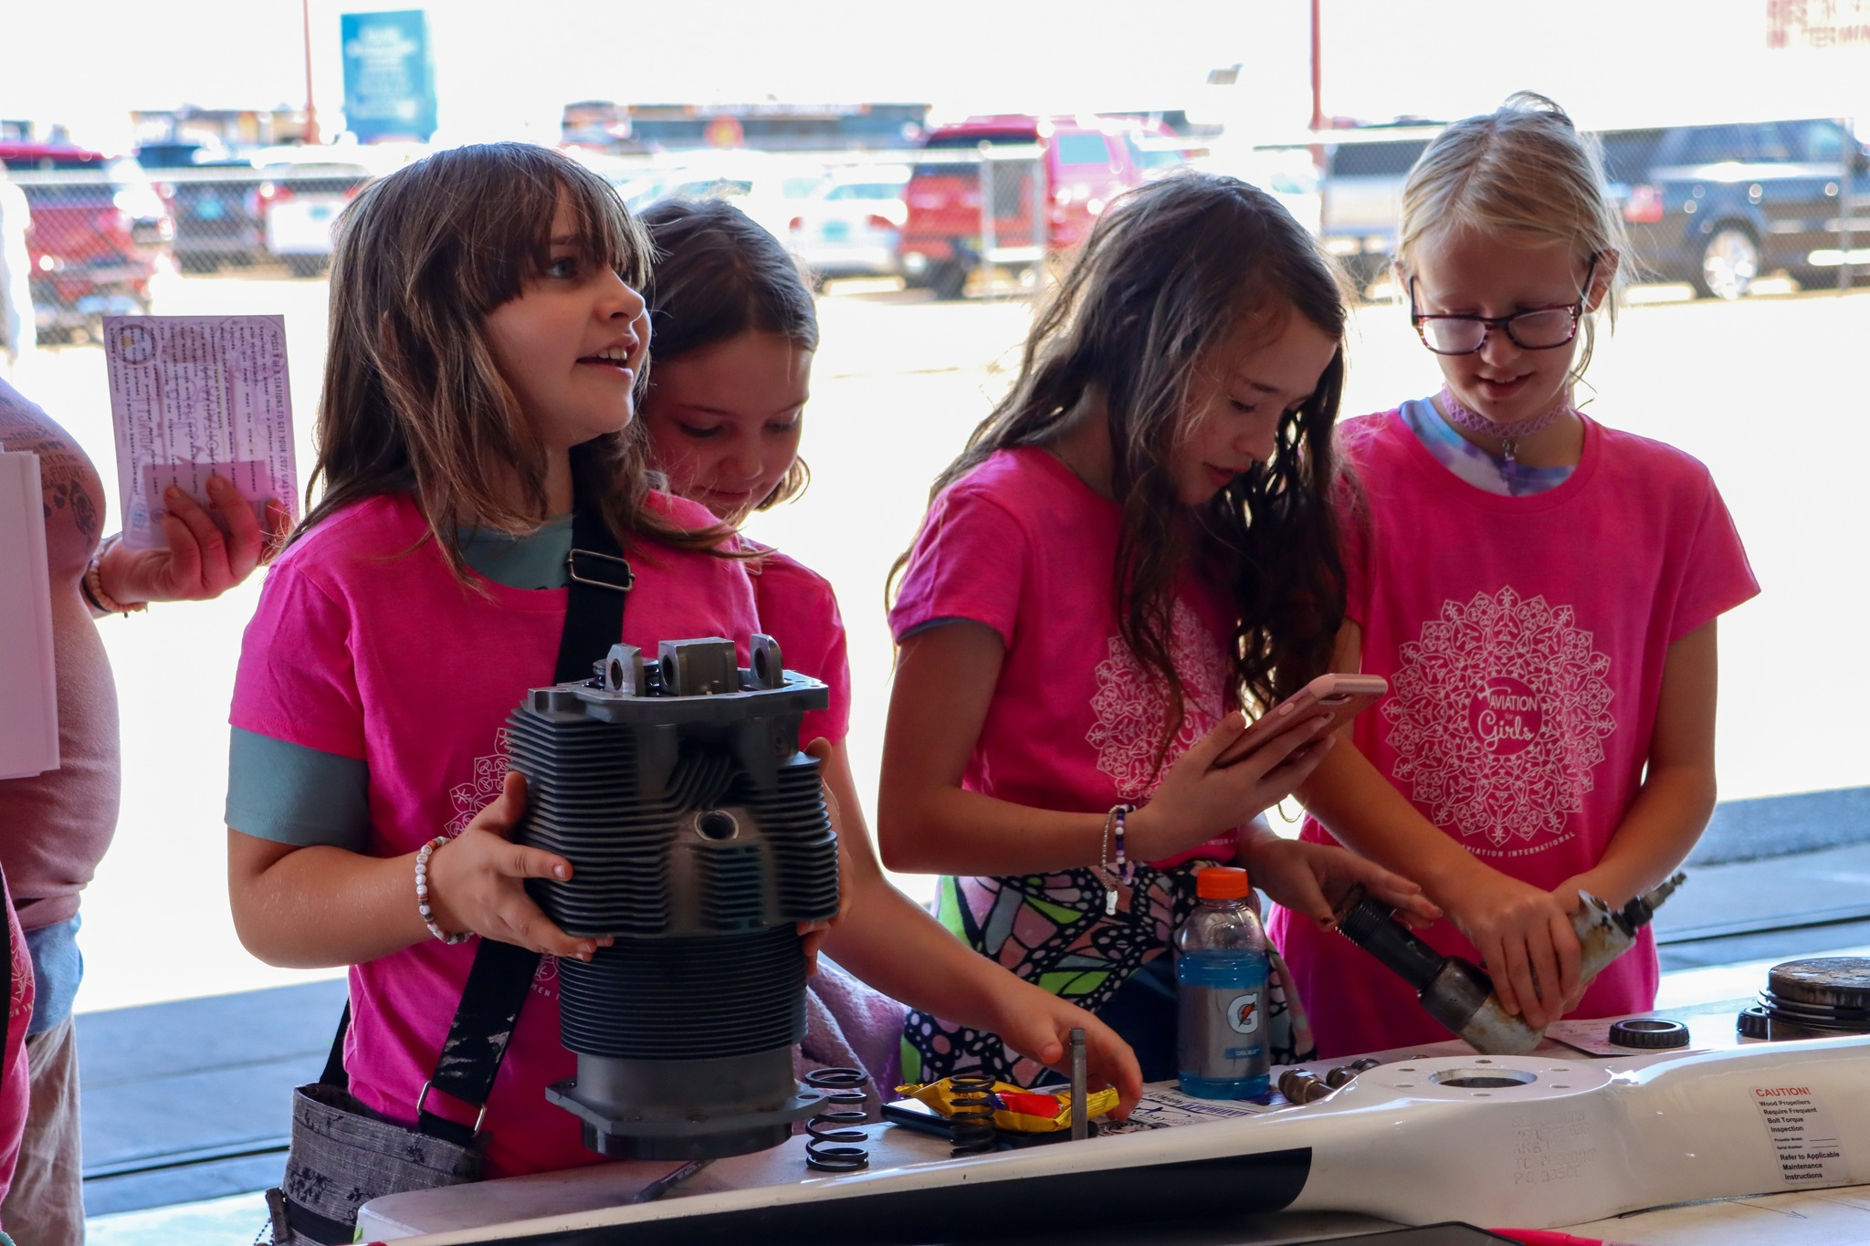
The Future of WAI

